Slide 1
Animal Movie User Reviews
Analysis by Jay Sampat

Slide 2
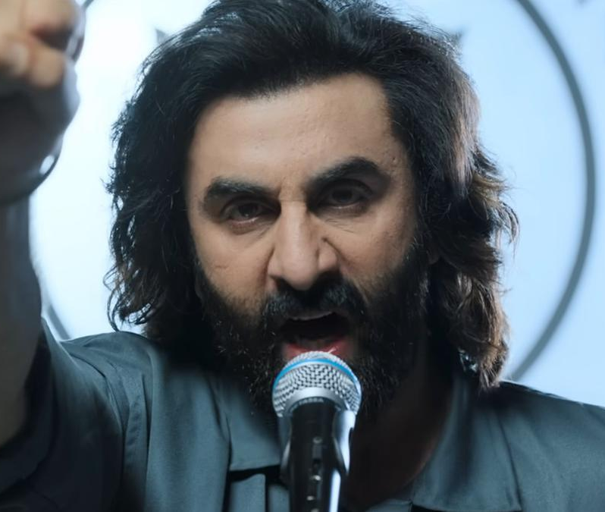



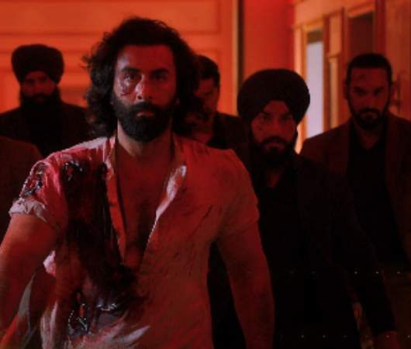

Slide 3
My Question
“Cheerfully Misogynistic”
“Morally Bankrupt”
“Stomach-Churningly Violent”
# 5 Highest Grossing Hindi Language Movie of All Time
Critics Clearly Did NOT Like it, but Audiences Did. How do Audiences Really Feel?

Slide 4

My Data
1,224 IMDB User Reviews + Corresponding Ratings

Slide 5
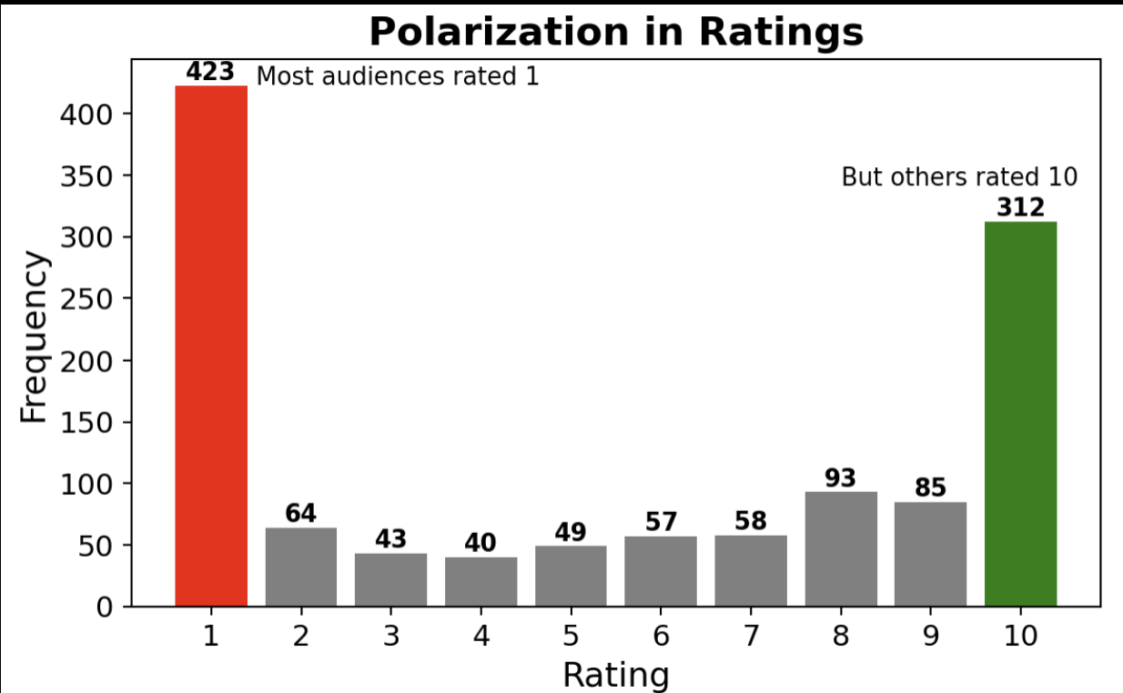
EDA – Distribution of Ratings

Slide 6
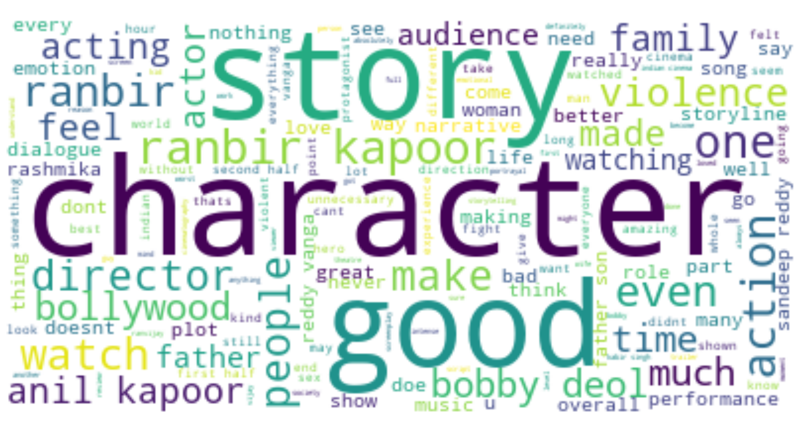
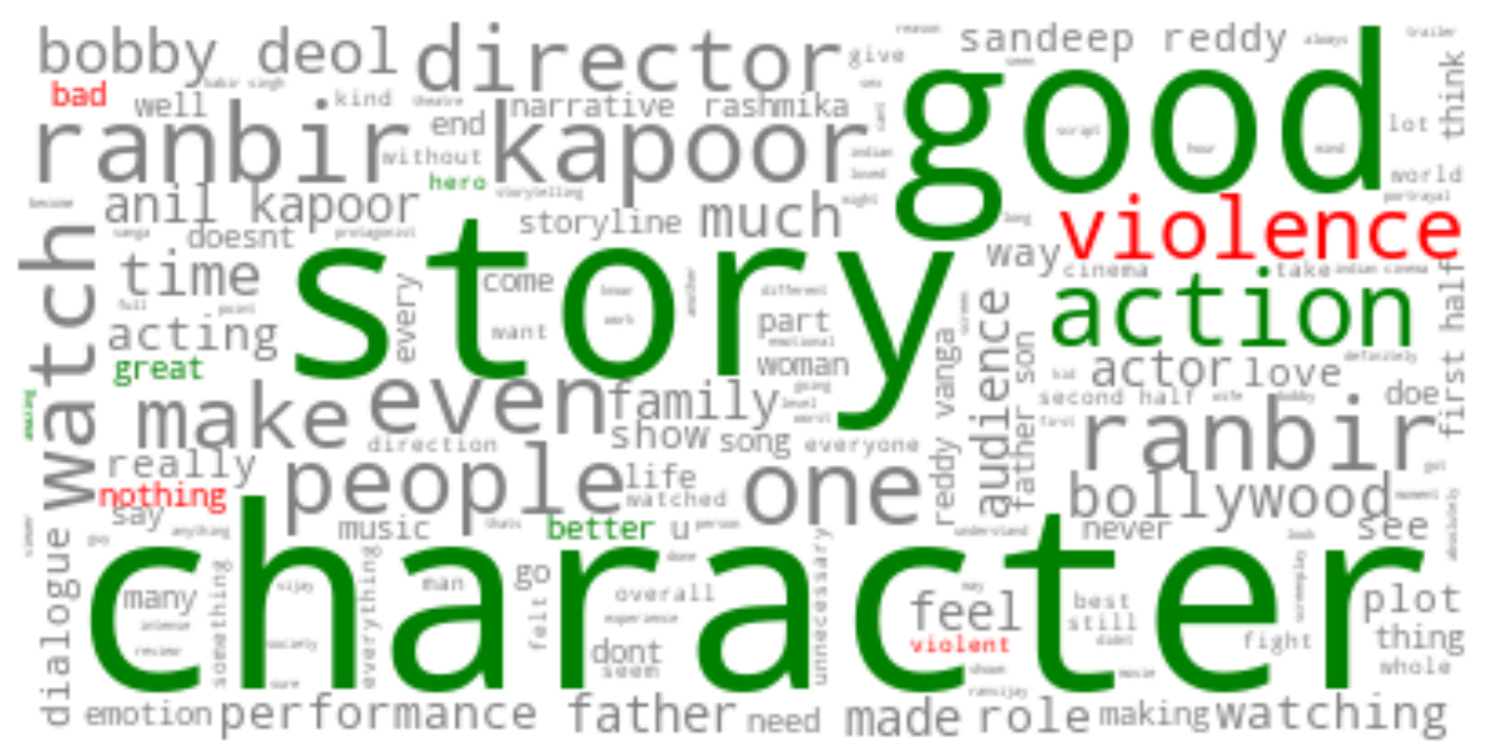
WordCloud

Slide 7
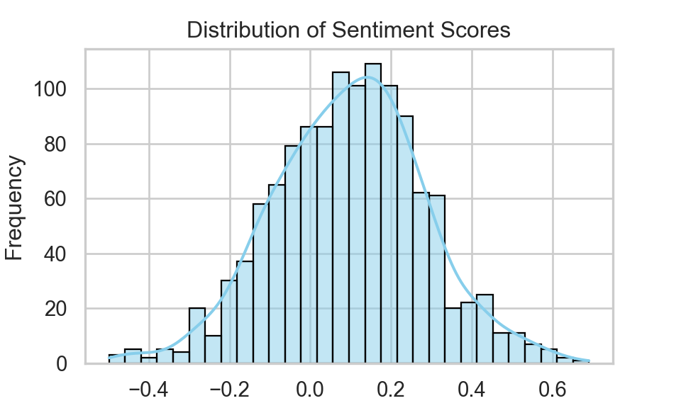
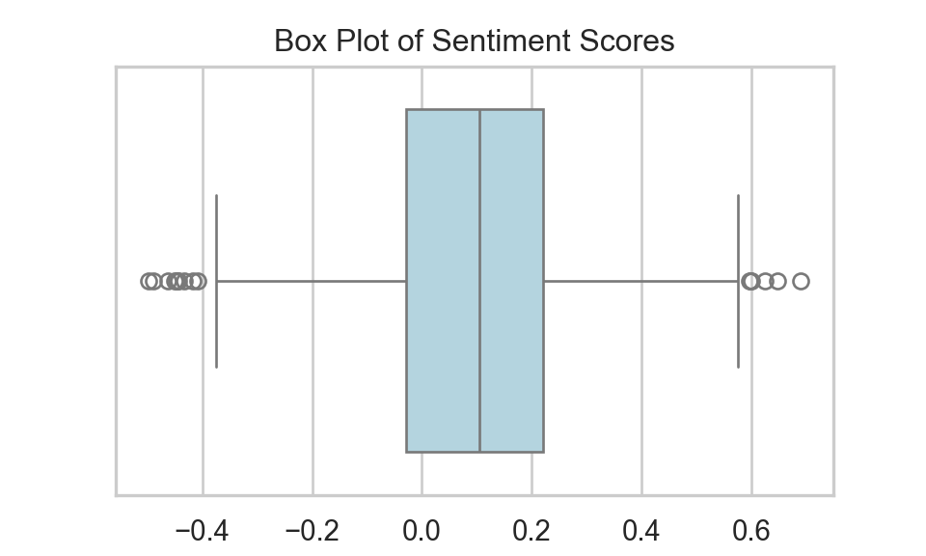
Sentiment Analysis Results
count | 1224
mean | 0.097
std | 0.186
min | -0.498
25% | -0.029
50% | 0.104
75% | 0.220
max | 0.690
Correlation Between a Reviewer’s Sentiment and their Rating: 0.225

Slide 8
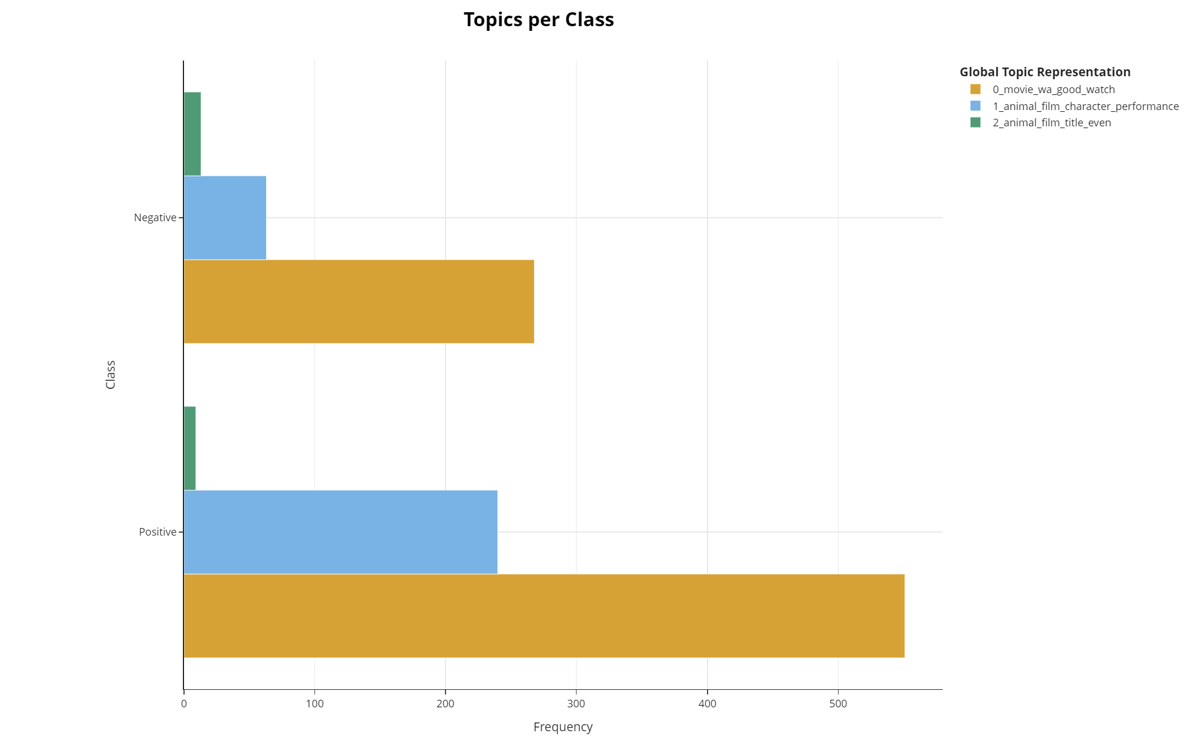
BERTopic Topic Modeling Analysis

Slide 9
Conclusion
Despite Most 1-star Ratings, Audiences Clearly Liked the Movie
Polarizing Movie: People Will Come to Watch it
Problematic Themes: Mirror to Society?

